Slide 1

Lecture 03: Digital System Design
Dept. of Computer Sc. and Engg.
University of Rajshahi
www.ru.ac.bd
Dr. Mahboob Qaosar

Slide 2
1-bit Adder
Performs the addition of two binary bits.
Four possible operations:
0+0=0
0+1=1
1+0=1
1+1=10
Circuit implementation requires 2 outputs; one to indicate the sum and another to indicate the carry.

Slide 3
Half Adder
Performs 1-bit addition.
Inputs: A, B
Outputs: S, C
Index indicates significance, 0 is for LSB and 1 is for the next higher significant bit.
Boolean equations:
S = AB’+A’B = A ⊕ B
C = AB
Truth Table
A
B
S
C
0
0
0
0
0
1
1
0
1
0
1
0
1
1
0
1

Slide 4
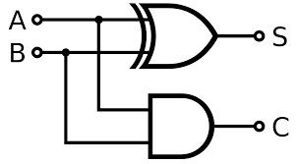
Half Adder (cont.)
S = AB’+A’B = A⊕ B
C = AB
Block Diagram
A
B
1 bit
half adder
C
S

Slide 5
n-bit Addition
Design an n-bit binary adder which performs the addition of two n-bit binary numbers and generates a n-bit sum and a carry out.
Example: Let n=4 C_{out} C₃ C₂ C₁ C₀ 1 1 0 1 0
A₃ A₂ A₁ A₀ 1 1 0 1 + B₃ B₂ B₁ B₀ + 1 1 0 1 --------------------- --------------- S₃ S₂ S₁ S₀ 1 1 0 1 0

Slide 6
Full Adder
Full adder (for higher-order bit addition)
Combinational circuit that performs the additions of 3 bits (two bits and a carry-in bit)
A_{i}
B_{i}
1 bit
full adder
C_{i+1}
C_{i}
S_{i}

Slide 7
Full Adder (cont.)
The K-maps for
C_{i+1}:
S_{i}:
B_{i}C_{i}
A_{i}
B_{i}
C_{i}
S_{i}
C_{i+1}
A_{i}
0
0
1
0
0
0
0
0
0
0
0
1
1
0
0
1
1
1
0
1
0
1
0
0
1
1
0
1
B_{i}C_{i}
1
0
0
1
0
A_{i}
0
1
0
1
1
0
1
0
1
1
1
0
0
1
1
0
1
0
1
1
1
1
1

Slide 8
Full Adder (cont.)
Boolean equations:
C_{i+1} = A_{i}B_{i} + A_{i}C_{i} + B_{i}C_{i}
S_{i} = A_{i}B_{i}’ C_{i}’ + A_{i}’B_{i}’C_{i} + A_{i}’B_{i}C_{i}’ + A_{i}B_{i}C_{i} = A_{i} ⊕ B_{i} ⊕ C_{i}
You can design full adder circuit directly from the above equations (requires 3 ANDs and 1 OR for C_{i+1} and 2 XORs for S_{i})

Slide 9
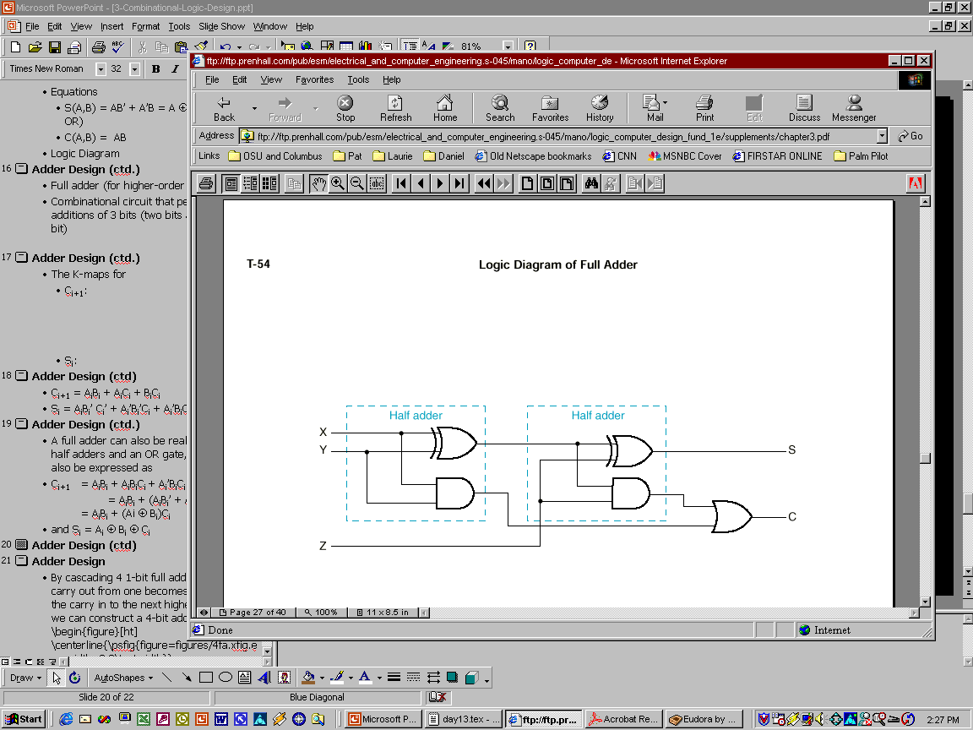
Full Adder using 2 Half Adders
A full adder can also be realized with two half adders and an OR gate, since C_{i+1} can also be expressed as:
C_{i+1} = A_{i}B_{i}C_{i} + A_{i}B_{i}C_{i}’ + A_{i}B_{i}’C_{i} + A_{i}’B_{i}C_{i}
= A_{i}B_{i}(C_{i} + C_{i}’) + (A_{i}B_{i}’ + A_{i}’B_{i})C_{i} = A_{i}B_{i} + (A_{i} ⊕ B_{i})C_{i}
and S_{i} = A_{i} ⊕ B_{i} ⊕ C_{i}
A_{i}
B_{i}
S_{i}
C_{i+1}
C_{i}

Slide 10
n-bit Combinational Adders
Perform parallel multi-bit addition
Ripple Carry Adder
Simple design
Time consuming.
Carry Look ahead Adder
More complex than ripple-carry adder
Reduces circuit delay

Slide 11
n-bit Ripple Carry Adder
Constructed using n 1-bit full adder blocks in parallel.
Cascade the full adders so that the carry out from one becomes the carry in to the next higher bit position.

Slide 12
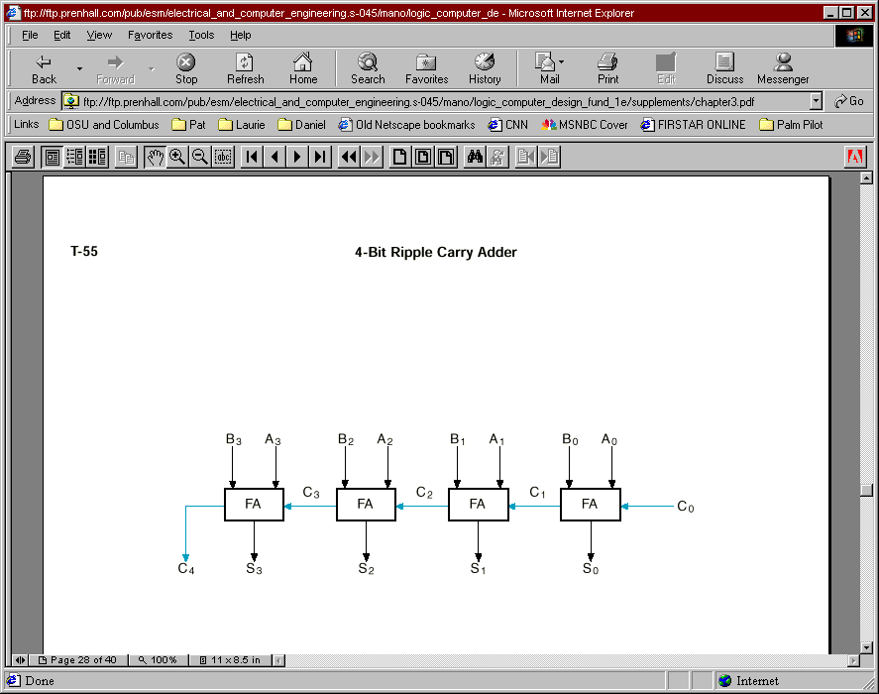
Example: 4-bit Ripple Carry Adder
C₄ C3 C2 C1 C0 A3 A2 A1 A0 +B3 B2 B1 B0 -------------- S3 S2 S1 S0

Slide 13
Binary Subtractor
Implement subtraction with 2’s complement number system
A-B = A + (-B) = A + 1’sc (B) + 1
Implement 1’sc with XOR gates:

Slide 14
Binary Adder/Subtractor
4-Bit Binary Adder/Subtractor

Slide 15
Ripple Carry Adder Delay
Circuit delay in an n-bit ripple carry adder is determined by the delay on the carry path from the LSB (C₀) to the MSB (C_{n}).
Let the delay in a 1-bit FA be Δ. Then, the delay of an n-bit ripple carry adder is nΔ.

Slide 16
Carry Look ahead Adder
Alternative design for a combinational n-bit adder.
Practical design with reduced delay at the expense of more complex hardware.
Derived from a transformation of the ripple carry adder design.

Slide 17
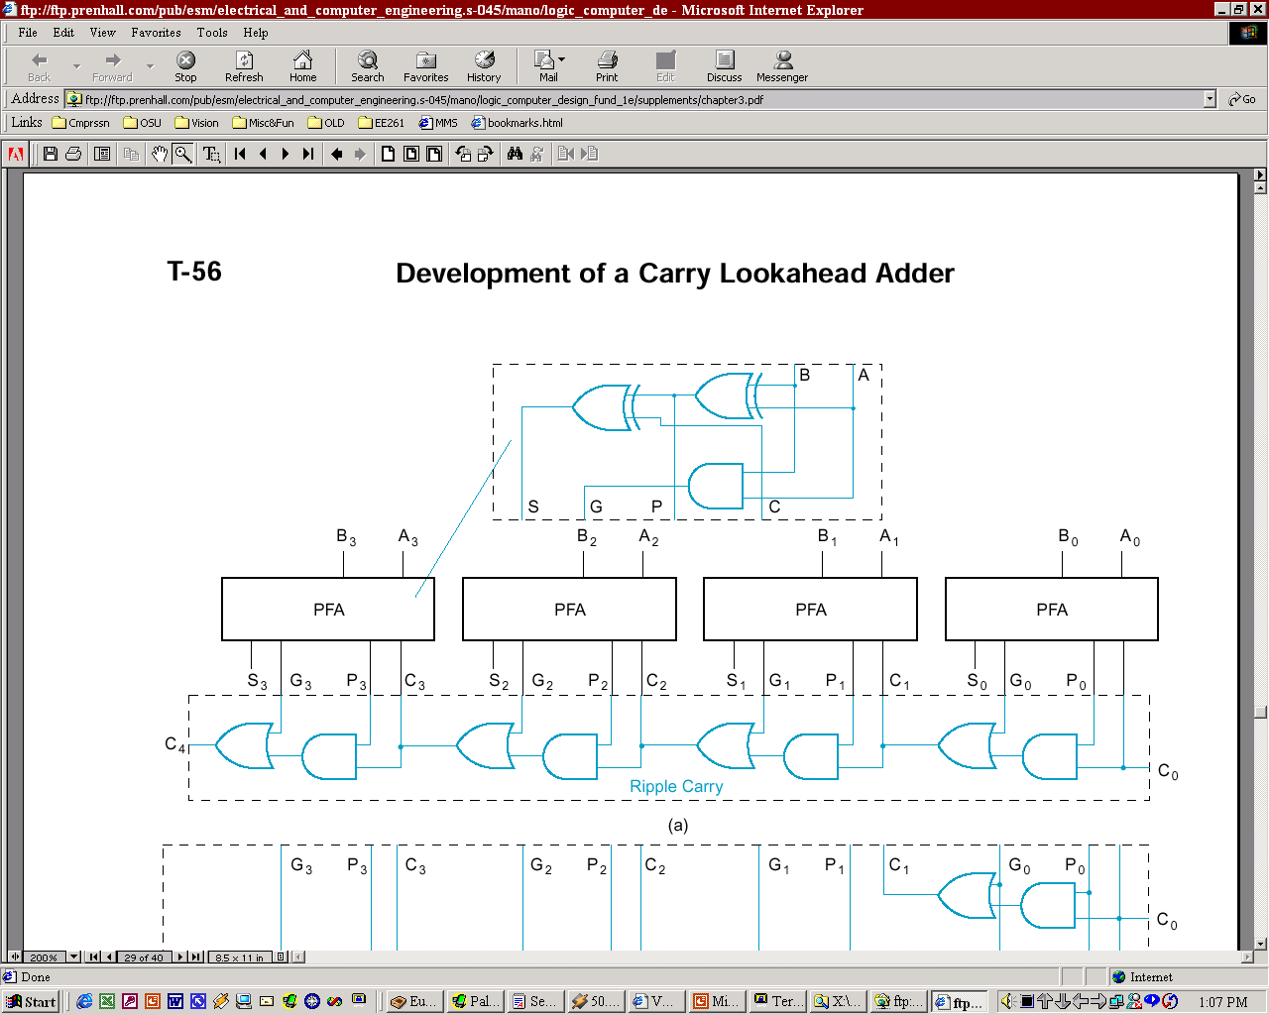
Carry Lookahead Adder Design
From a FA, separate between carry generation (a new carry signal is generated, i.e. C_{out}=1) and carry propagation (an existing C_{in} is propagated to C_{out})
Generate: G_{i} = A_{i}B_{i}: if 1, C_{i+1}=1
Propagate: P_{i} = A_{i} ⊕ B_{i}: if 1, C_{i+1} = C_{i}
Full Adder (FA)
Partial Full Adder (PFA)
B_{i}
A_{i}
A_{i}
B_{i}
S_{i}
C_{i+1}
C_{i}
S_{i}
G_{i}
P_{i}
C_{i}

Slide 18
Carry Lookahead Adder Design (cont.)
C_{i+1} = G_{i} + P_{i}C_{i}
PFA design breaks S functionality apart from G/P functionality

Slide 19
Carry Look ahead Adder (cont.)
Does this (design in previous slide) solve the long delay problem?
No, carry out still “ripples” !
Idea: use two levels of logic to generate carry out of any block C_{i} in terms of carry in C₀ and addend bits A_{i} and B_{i}

Slide 20
Block CLA
Implement:
C₁ = G₀+P₀ C₀
C₂ = G₁+P₁C₁ = G₁+P₁(G₀+P₀C₀) = G₁+P₁G₀+P₁P₀C₀
C₃ = G₂ + P₂C₂ = G₂+P₂G₁+P₂P₁G₀+P₂P₁P₀C₀
C₄ = G₃+P₃G₂+P₃P₂G₁+P₃P₂P₁G₀ + P₃P₂P₁P₀ C₀ = G₀₋₃ + P₀₋₃C₀
Group carry generate
Group carry propagate

Slide 21
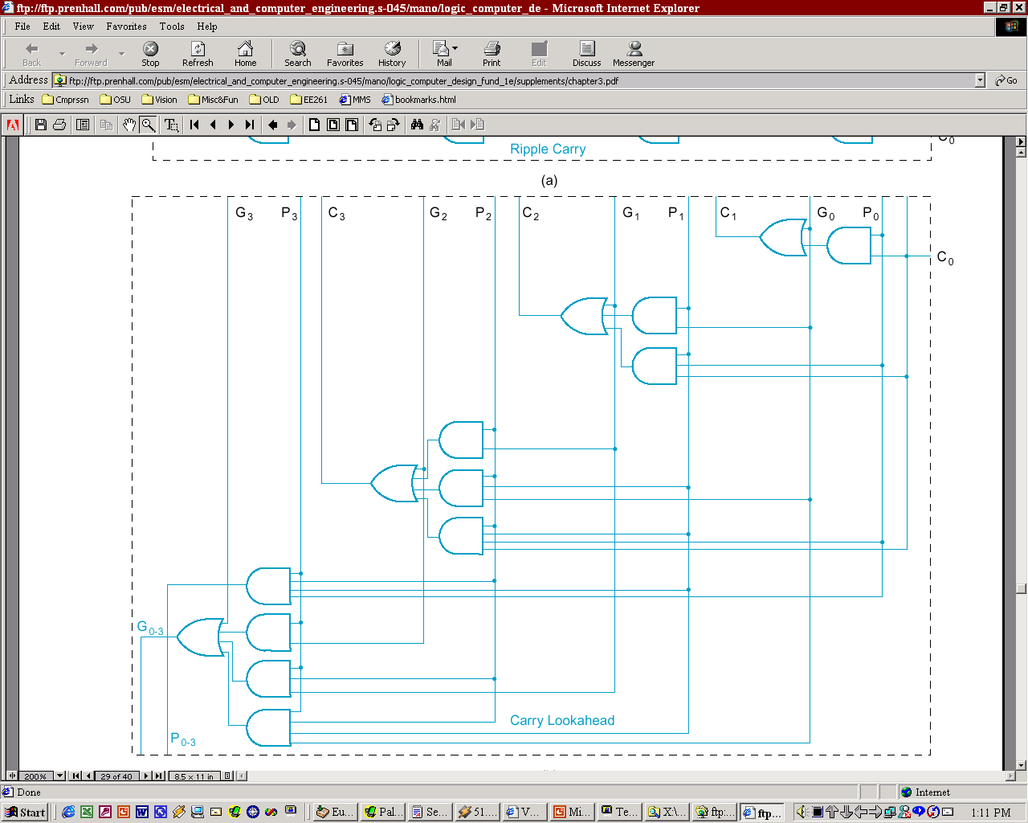
Generate/Propagate logic of a 4-bit CLA
-- C₀ … C_{n-1} have a 2-gates delay
-- C₄ = G₀₋₃+P₀₋₃C₀
has a 3-gates delay

Slide 22
BCD Adder

Slide 23
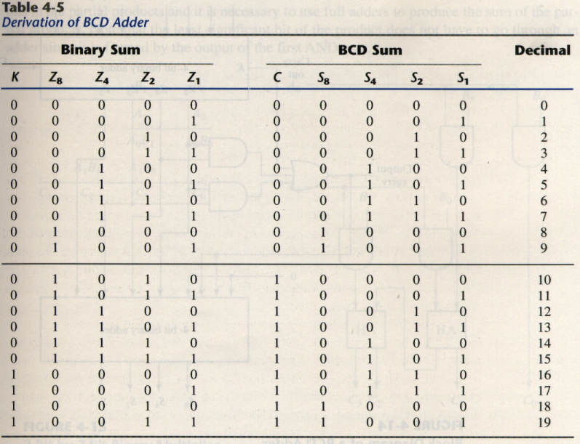
BCD adder
BCD adder can’t exceed 9 on each input digit. K is the carry.

Slide 24
Rules of BCD adder
When the binary sum is greater than 1001, we obtain a non-valid BCD representation.
The addition of binary 6(0110) to the binary sum converts it to the correct BCD representation and also produces an output carry as required.
To distinguish them from binary 1000 and 1001, which also have a 1 in position Z₈, we specify further that either Z₄ or Z₂ must have a 1.
C = K + Z₈Z₄ + Z₈Z₂

Slide 25
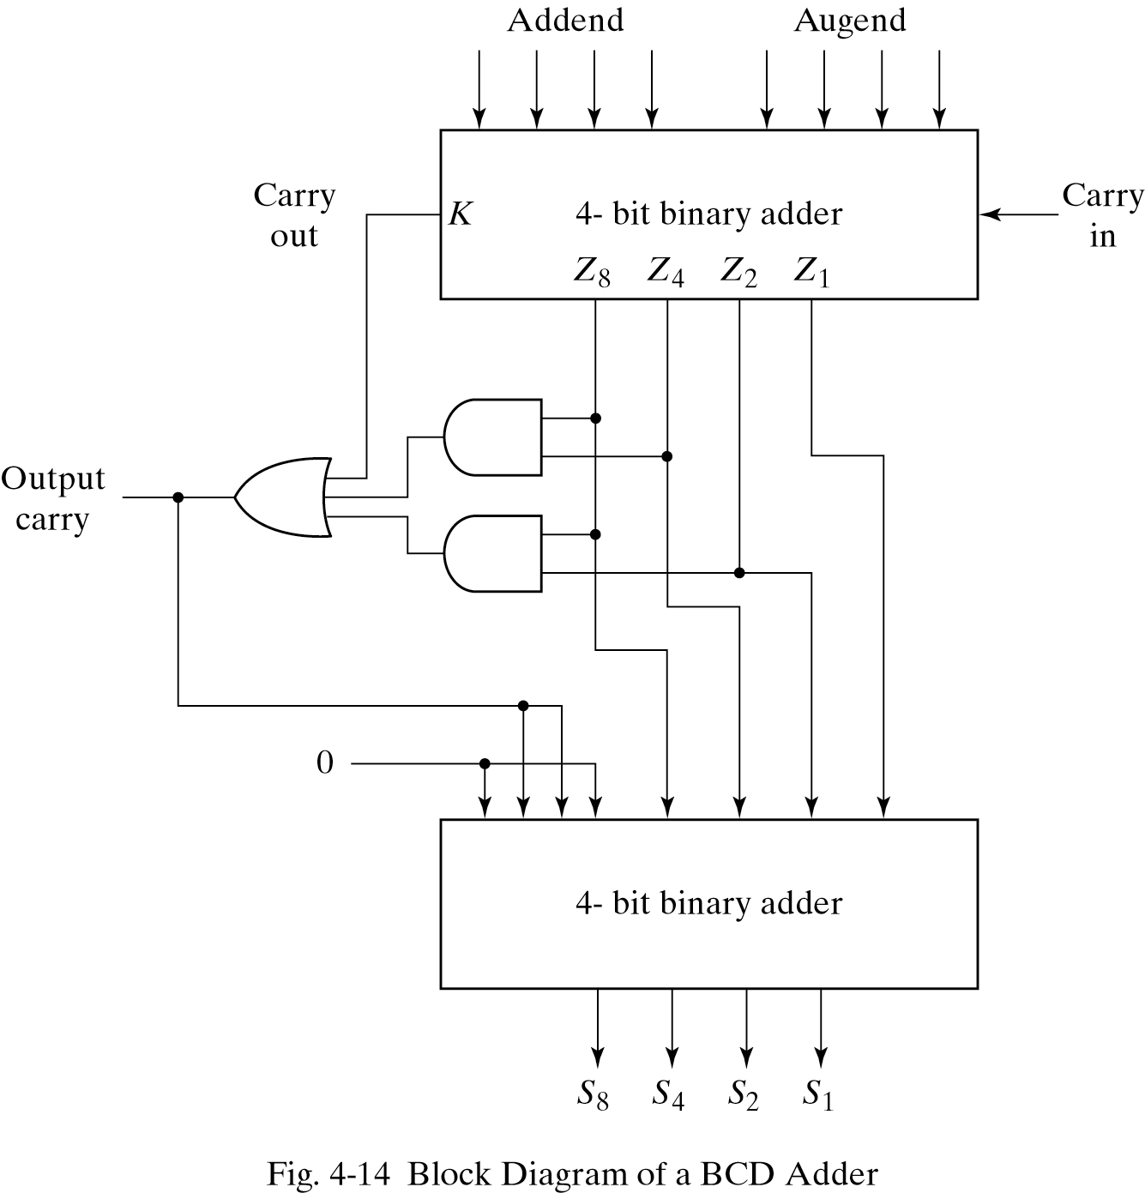
Implementation of BCD adder
A decimal parallel adder that adds n decimal digits needs n BCD adder stages.
The output carry from one stage must be connected to the input carry of the next higher-order stage.
If =1
0110

Slide 26
Comparator

Slide 27
1 Bit Digital Comparator Truth Table
Inputs |  | Outputs
B | A | A > B | A = B | A < B
0 | 0 | 0 | 1 | 0
0 | 1 | 1 | 0 | 0
1 | 0 | 0 | 0 | 1
1 | 1 | 0 | 1 | 0

Slide 28
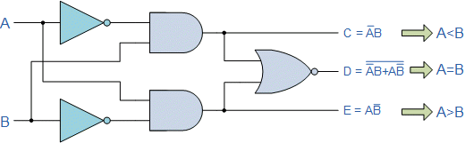

Slide 29
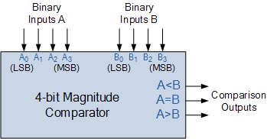

Slide 30
